Slide 1


TOASTMASTERS DISTRICT 84
FROM LEADER
TO TRAINER
PRESENTED BY DR. MARIA MARTINEZ, DTM
2023-2024 EDUCATION CHAIR

Slide 2



SOCIAL EXPERIMENT
TOASTMASTER LEADER: TRAINER (2024)
Notes:
Please stand up if you have delivered a training at TLI, Conference, at a Club, Area or Division event?
Felicia, please take note :)
From of you standing, how many are in the Learning and Development space or received formal training in your jobs or outside of Toastmasters?
What's the correlation?
In my experience and based on my very informal experiment, as we take the Toastmasters promise and start growing in our TM journey, the opportunities to train, facilitate and to share knowledge also increase.

Slide 3
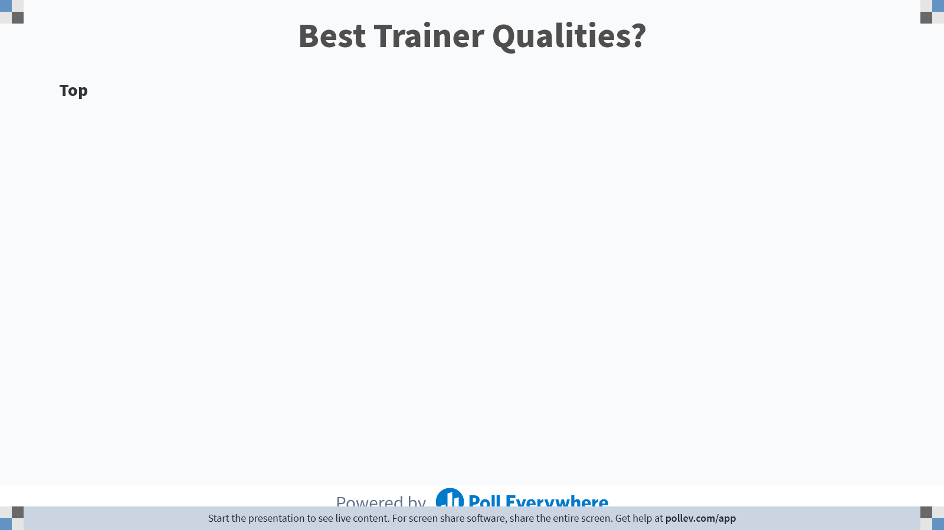
Notes:
Poll Title: Do not modify the notes in this section to avoid tampering with the Poll Everywhere activity.
More info at polleverywhere.com/support
Best Trainer Qualities?
https://www.polleverywhere.com/discourses/u6mH0d9ifws25fZRBgZMu

Slide 4

TODAY'S
MODERN LEARNER
  Impatient
  Distracted
  Overwhelmed
  Social
  Thirst for learning
SOURCE: BERSIN BY DELOITTE (2020)
TOASTMASTER LEADER: TRAINER
Notes:
Today's learner wants learning that is immediate, focused and relevant to their needs. Understanding how adults learn, and the associated challenges is key to building trust and conveying the information in a learner-centric approach.
Research by Deloitte portrays �the modern learner� as impatient, easily distracted, overworked and often overwhelmed � but with a thirst for learning that�s fuelled by easier access to information and learning resources. Attention spans continue to decline � most learners will not watch videos longer than 4 minutes � and learning cycles are becoming shorter.
As a result, day-long training sessions in workplaces � reminiscent of the school classroom � are no longer fit for purpose. They�re too short for digital natives, too old-fashioned for digital immigrants, and generate too little ROI in terms of time spent, knowledge retention and engagement.
Interruptions every 5 minutes
Modern learner unlocks their phone up to 9 times per hour
Shorter attention span - videos no longer than 4 minutes
5-10 seconds to grab attention before they click away
social media increases hormones by as much as 13%
73% say the process info more deeply when they share it
85% say reading other people's responses helps undersatnd and process information and events
https://www.growthengineering.co.uk/understanding-the-modern-learner-7-defining-traits/

Slide 5






WHO IS OUR AUDIENCE?
TOASTMASTER LEADER: TRAINER
Notes:
According to the most recent Fact Sheet available *July 2021 to June 2022, our members:
Average age 47 years
Almost 80% has a bachelor's degree or higher,
42% multilingual
55% female

Slide 6

ADULT LEARNING THEORY
TOASTMASTER LEADER: TRAINER
Notes:
There are many adult learning theories including neuroscience, experiential learning, self-directed learning and transformational learning.
Developed in 1968 by Malcolm Knowles, andragogy is a term that refers to the concept of adult learning and how it differs from children’s education. Knowles defines andragogy as “the art and science of teaching adults.” According to Knowles, andragogy, also known as adult learning, is premised on five key assumptions: self-concept, adult learner experience, readiness to learn, orientation of learning, and motivation to learn.
Knowles believed that these are the five pillars of adult learning, and each must be taken into account for shaping adult education programs accordingly. Today, the education programs for adult training are still built around andragogy—instead of education being teacher-centric, much of the curriculum’s focus is given to students and their learning needs.

Slide 7

TOASTMASTER LEADER: TRAINER
Notes:
https://youtu.be/UgNeWsbKDUY

Slide 8

KNOWLES' THEORY - 5 ASSUMPTIONS
Readiness
Experience
Orientation
Self-Concept
Motivation
Notes:
1. Self-concept: Adults become more self-directed as they mature
as adults move throughout life, they become more independent and self-directed. Adult learners want to have ownership over their learning journey. This is why learning experience platforms (LXPs) and the advancement of eLearning have been huge in the learning industry—these tools allow adult learners to take ownership of what they learn and how they learn it.
It can be easy to make assumptions about what learners might need—especially from the position of leadership, which might not be as connected to the day-to-day work of the employees who actually need the training. Instead, consider giving your learners some freedom to make their own choices in their learning journey, whether that’s by allowing them to choose their learning paths or how they receive their information.
2. Learner experience: Adults bring a wealth of experience to the learning process
The second assumption Malcolm Knowles made is about the learner experience. Unlike children who are frequently learning things for the first time without previous experience, adult learners bring the richness of past education, jobs, and life events to learning experiences. Basically, don’t assume your learners are beginners without first understanding the knowledge they bring to the table.
Even if the concepts and skills you’re introducing are new, remember that adult learners may have skills and lived experiences that they can reference to enrich their own process of discovery and growth. Finding ways to integrate this with discussion groups and debriefs can be an effective way to help your learners feel like you see the value they bring, too.
3. Readiness to learn: Adults want to learn things that help them accomplish relevant tasks
You might’ve heard that adults care a lot about the “why” behind learning, and that’s where Knowles’ next assumption about “readiness to learn” comes in. Unlike children, who absorb everything they can as they grow up, adult learners are more selective with what information they take in. Common questions you might hear learners ask include, “How will this help me?” or, “What’s really in it for me?”
This is why the planning stage of any eLearning course or training is pivotal: you need to make it clear from the beginning what your learners are taking away from it and why that matters. Develop activities in your courses that mimic real-world job scenarios, include interactive elements, and make sure that what learners walk away with is applicable to their everyday job role experience.
4. Orientation to learning: Adult learners want to solve problems
Similar to readiness to learn, Malcolm Knowles spoke of adult learner orientation, noting that adults move away from subject-based learning, which centers around simply knowing about a concept, towards problem-based learning, which focuses on knowledge that tangibly contributes to problem solving.
Scenario-based learning can be incredible for teaching your adult learners problem-solving skills while avoiding costly mistakes on the job. See how this style of learning can engage learners and help them perform better in their roles.
5. Motivation to learn: Adults rely on internal rather than external motivation
Finally, Knowles made an assumption about adult motivation to learn. While children have external sources of motivation to learn—including parents, teachers, or the societal push for higher education—once learners become adults, they no longer have those same external motivators. They get replaced by internal motivators, which are individual to each learner.
Internal motivations for learners could be to get a raise or promotion, to improve their skills in a relevant area, or to improve their life both in and outside of the workplace. It’s important that companies spend time understanding what motivates their learners so that these motivators can be part of what shapes the learning development process.
https://maestrolearning.com/blogs/malcolm-knowles-five-assumptions-of-learners-and-why-they-matter/

Slide 9

4 PRINCIPLES
Draw from experience
Involve them
Problem-Centered
Relevance
Notes:
1. Self-concept: Adults become more self-directed as they mature
The first of Knowles’ assumptions is this: as adults move throughout life, they become more independent and self-directed. Adult learners want to have ownership over their learning journey. This is why learning experience platforms (LXPs) and the advancement of eLearning have been huge in the learning industry—these tools allow adult learners to take ownership of what they learn and how they learn it.
It can be easy to make assumptions about what learners might need—especially from the position of leadership, which might not be as connected to the day-to-day work of the employees who actually need the training. Instead, consider giving your learners some freedom to make their own choices in their learning journey, whether that’s by allowing them to choose their learning paths or how they receive their information.
2. Learner experience: Adults bring a wealth of experience to the learning process
The second assumption Malcolm Knowles made is about the learner experience. Unlike children who are frequently learning things for the first time without previous experience, adult learners bring the richness of past education, jobs, and life events to learning experiences. Basically, don’t assume your learners are beginners without first understanding the knowledge they bring to the table.
Even if the concepts and skills you’re introducing are new, remember that adult learners may have skills and lived experiences that they can reference to enrich their own process of discovery and growth. Finding ways to integrate this with discussion groups and debriefs can be an effective way to help your learners feel like you see the value they bring, too.
3. Readiness to learn: Adults want to learn things that help them accomplish relevant tasks
You might’ve heard that adults care a lot about the “why” behind learning, and that’s where Knowles’ next assumption about “readiness to learn” comes in. Unlike children, who absorb everything they can as they grow up, adult learners are more selective with what information they take in. Common questions you might hear learners ask include, “How will this help me?” or, “What’s really in it for me?”
This is why the planning stage of any eLearning course or training is pivotal: you need to make it clear from the beginning what your learners are taking away from it and why that matters. Develop activities in your courses that mimic real-world job scenarios, include interactive elements, and make sure that what learners walk away with is applicable to their everyday job role experience.
4. Orientation to learning: Adult learners want to solve problems
Similar to readiness to learn, Malcolm Knowles spoke of adult learner orientation, noting that adults move away from subject-based learning, which centers around simply knowing about a concept, towards problem-based learning, which focuses on knowledge that tangibly contributes to problem solving.
Scenario-based learning can be incredible for teaching your adult learners problem-solving skills while avoiding costly mistakes on the job. See how this style of learning can engage learners and help them perform better in their roles.
5. Motivation to learn: Adults rely on internal rather than external motivation
Finally, Knowles made an assumption about adult motivation to learn. While children have external sources of motivation to learn—including parents, teachers, or the societal push for higher education—once learners become adults, they no longer have those same external motivators. They get replaced by internal motivators, which are individual to each learner.
Internal motivations for learners could be to get a raise or promotion, to improve their skills in a relevant area, or to improve their life both in and outside of the workplace. It’s important that companies spend time understanding what motivates their learners so that these motivators can be part of what shapes the learning development process.
https://maestrolearning.com/blogs/malcolm-knowles-five-assumptions-of-learners-and-why-they-matter/

Slide 10

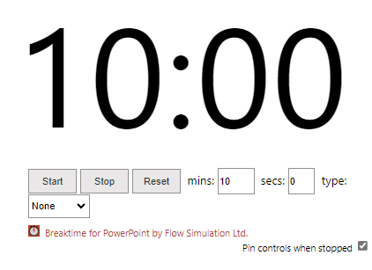
GROUP EXERCISE
Identify a topic you might be training your clubs on:
  Consider what is the most effective way to convey the information.
  How would you apply the principles of Andragogy?
  Have a reporter share with the group
TIME LIMIT: 10 MINUTES
TOASTMASTER LEADER: TRAINER

Slide 11


ANDRAGOGY 101
  Need for knowledge – the why
  Self-direction – let them own it
  Experience – build on
  Readiness –the WIIFM
  Orientation – solve problems
  Motivation – the benefits
TOASTMASTER LEADER: TRAINER
Notes:
1. Need for knowledge - adults need to understand the relevance of the learning content. --> make it clear why specific things are taught
2. Self-direction - adults like to influence the what, where and when of learning --> make room for the customization of content
3. experience - adults have many experiences to base new knowledge on --> allow for prior knowledge to be incorporated into the course
4. readiness - adults are ready to meet the requirements of their role --> illustrate how the learning content will be beneficial
5. Orientation - adults learn problem oriented, favoring immediate application of knowledge --> include practical learning experiences to try and apply new skills
6. Motivation - adults are eager to grow and develop their skills--> explain the ways in which the content will further their career

Slide 12





TIPS
  Know your content
  Prepare effective aids
  Engage your audience
  Check for understanding
  Ask questions (and listen!)
  Provide application
  Use humor & fun
  Build trust
  Read the room
  Manage time and energy
TOASTMASTER LEADER: TRAINER (2023)

Slide 13

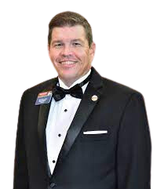



  Darren LaCroix in Lakeland!
  Train-the-Trainer - Register now
  Trainers Academy
  TLI: Transform. Lead. Inspire
  Educational Summit
GET READY!
All details on ToastmastersD84.org
TOASTMASTER LEADER: TRAINER (2023)

Slide 14
WHAT IS ONE THING?
TOASTMASTER LEADER: TRAINER
Notes:
1. Need for knowledge - adults need to understand the relevance of the learning content. --> make it clear why specific things are taught
2. Self-direction - adults like to influence the what, where and when of learning --> make room for the customization of content
3. experience - adults have many experiences to base new knowledge on --> allow for prior knowledge to be incorporated into the course
4. readiness - adults are ready to meet the requirements of their role --> illustrate how the learning content will be beneficial
5. Orientation - adults learn problem oriented, favoring immediate application of knowledge --> include practical learning experiences to try and apply new skills
6. Motivation - adults are eager to grow and develop their skills--> explain the ways in which the content will further their career

Slide 15
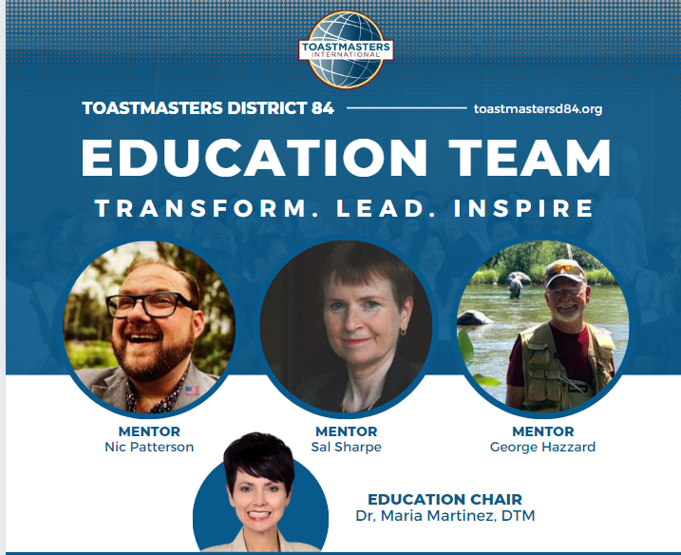
#THESQUAD

Slide 16


THANK YOU!
WHAT QUESTIONS DO YOU HAVE?
DR. MARIA MARTINEZ, DTM
EDUCATION CHAIR 2023-24

